Slide 1

Loan Repayment Prediction
Using Machine Learning Techniques

Slide 2

Overview:
Welcome to the presentation on Loan Repayment Prediction, where we explore the application of machine learning techniques to forecast the likelihood of borrowers repaying their loans on time. In today's financial landscape, accurate prediction of loan repayment is paramount for lending institutions to manage risks effectively and ensure sustainable operations.

Slide 3

Objective:
Throughout this presentation, we will delve into the methodology, findings, and implications of our loan repayment prediction model. We'll provide insights into the dataset used, the machine learning algorithms employed, key performance metrics, and the practical applications of predictive modeling in lending practices. Our aim is to showcase the significance of predictive analytics in facilitating more efficient and equitable lending processes.

Slide 4
Dataset Description:
The analysis in this presentation is based on a comprehensive loan records dataset, encompassing various attributes related to borrowers and their loan profiles. The dataset includes features such as loan amount, loan term, interest rate, employment status, FICO credit score, and other relevant financial indicators.

Slide 5

Preprocessing Steps: Prior to model development, the dataset underwent rigorous preprocessing to ensure data quality and model robustness. This preprocessing involved steps such as:
Data Cleaning: Handling missing values, outliers, and inconsistencies in the dataset to ensure data integrity.
1
Feature Scaling: Standardizing or normalizing numerical features to a common scale to prevent dominance by certain variables.
2
Feature Engineering: Creating new features or transforming existing ones to enhance the predictive power of the model.
3
Data Splitting: Partitioning the dataset into training and testing sets to evaluate the model's performance effectively.
4

Slide 6
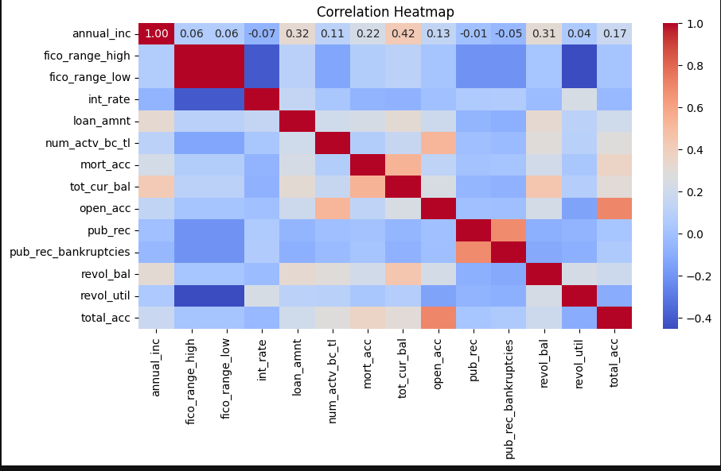
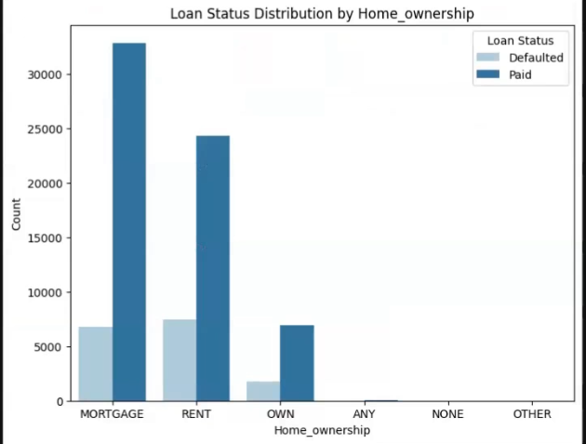
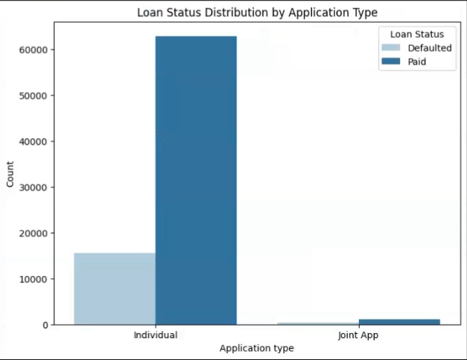
Visualisation:

Slide 7
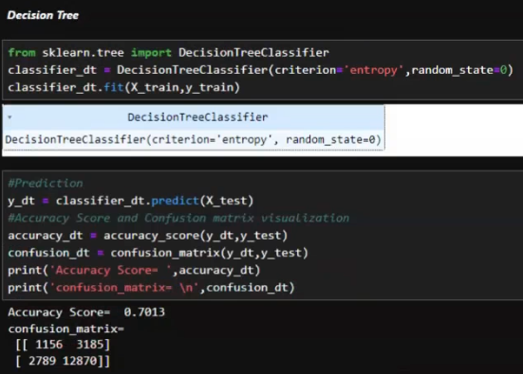
Models: Decision Tree:
A decision tree is a machine learning algorithm that makes decisions by recursively splitting data based on features.

Slide 8
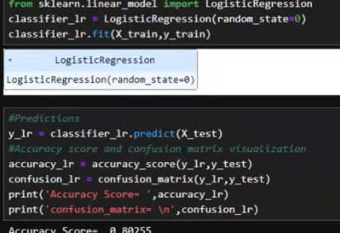
Logistic Regression:
Logistic regression is a statistical model used for binary classification tasks. It predicts the probability of an event occurring by fitting data to a logistic curve.

Slide 9
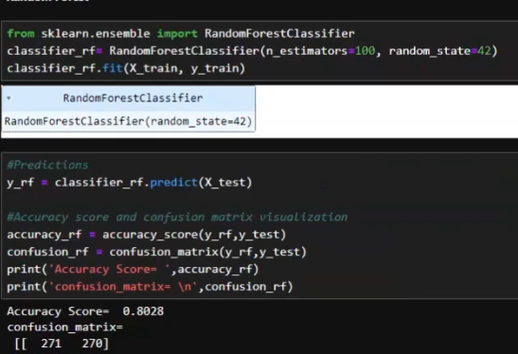
Random Forest:
Random Forest is a popular machine learning algorithm used for both classification and regression tasks. It operates by constructing multiple decision trees during training and outputs the mode (in classification) or mean (in regression) of the individual trees' predictions.

Slide 10
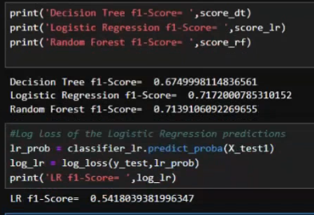
Results:
Decision Tree: Achieved an F1 score of 67%. While simple and interpretable, it may struggle with complex data relationships.
Logistic Regression: Outperformed the decision tree with an F1 score of 71%. Suitable for binary classification tasks like loan repayment prediction, leveraging features such as credit score, employment status, and loan amount.
Random Forest: Also scored 71%, like logistic regression. Utilizes multiple decision trees to handle non-linear relationships and feature interactions, enhancing predictive performance.

Slide 11
Conclusion:
Logistic regression and random forest models outperform decision trees in predicting loan repayment, achieving F1 scores of 71%.
Logistic regression offers insights into important features like credit score and employment status.
Random forest's ensemble approach enhances predictive accuracy by capturing complex data relationships.
Deploying these models can aid lenders in making informed decisions, reducing default risks, and promoting financial inclusion.

